Slide 1
TEAM - ETERNITY
CROWD TRACKER

Slide 2
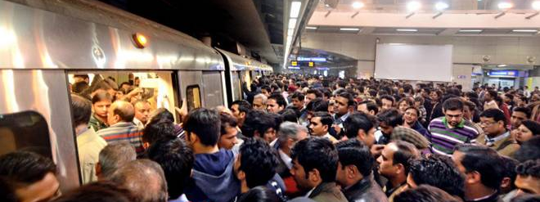
WHY CROWD TRACKER?????
To save Time and Effort.

Slide 3
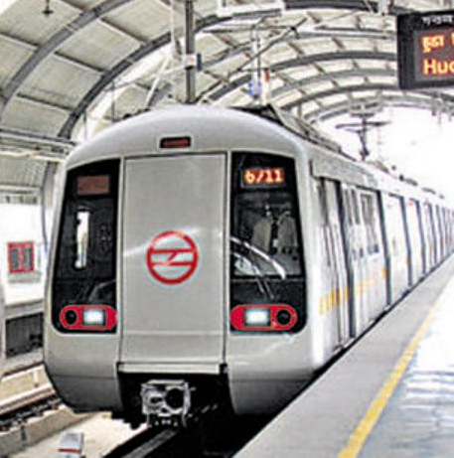
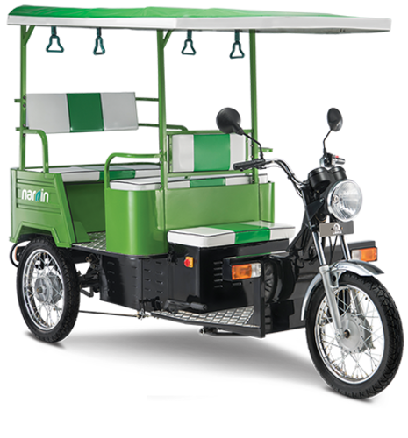
WHAT EXACTLY IS CROWD TRACKER?
IT IS A PRODUCT THAT AIMS UPON REDUCING THE TIME AND EFFORT OF USER VIA AN ANDROID APPLICATION.
THE USER WILL INPUT ITS LOCATION AND ITS PREFERRED DATE AND TIME FOR TRAVELLING VIA METROS.
OUR SYSTEM WILL PREDICT THE LIST OF NEARBY METRO STATIONS (RANK-WISE) ACCORDING TO CROWD INTENSITY TO OPTIMIZE USER TRAVEL TIME.
FURTHER WE HAVE ADDED ONE MORE FEATURE “BOOK YOUR RIDE” AND GUESS WHAT?
YOUR RIDE WILL BE AN E-RICKSHAW
REASONS FOR THIS
ENVIRONMENT FRIENDLY IN TERMS ON POLLUTION.
RESOURCE POOLING IN ORDER TO CUT TRAFFICS ON ROADS.

Slide 4
Modules involved
1. ANDROID UI DESIGN
2. INTEGRATION WITH BACKEND API
3. BUSINESS LAYER LOGIN
4. NOSQL DATABASE MANAGEMENT(MONGODB)
5. SERVER AND DATABASE HOSTED ON AWS

Slide 5
STEPS INVOLVED
1. COLLECTION OF DATA
2. PREPROCESSING OF DATA
3. ANALYSIS ON DATA
4. ANDROID APPLICATION TO INTERACT WITH USER
5. BACKEND APIs TO PROCESS USER REQUEST
6. PREDICTIONS USING PREPROCESSED DATA
7. SERVER AND DATABASE HOSTING ON AWS

Slide 6
THANKYOU
Team Members : Eternity
Shrey Batra - Backend
Ayushi Jain - AWS Cloud Hosting
Shaurya Uppal - Data Generation and Scaling
Anuj Jindal - Android
Akshat Aggarwal - Data Scaling

